Slide 1

Random PowerPoint Karaoke: A Fun and Spontaneous Presentation
Engaging topics for creativity and fun exploration
Notes:
AI-generated content may be incorrect. --- Welcome to our Random PowerPoint Karaoke! This presentation is a delightful mix of intriguing topics that will spark your imagination and creativity. Each slide will provide a snapshot of a unique subject, and we will explore them in a fun and spontaneous manner. Image source: Microsoft 365 content library

Slide 2
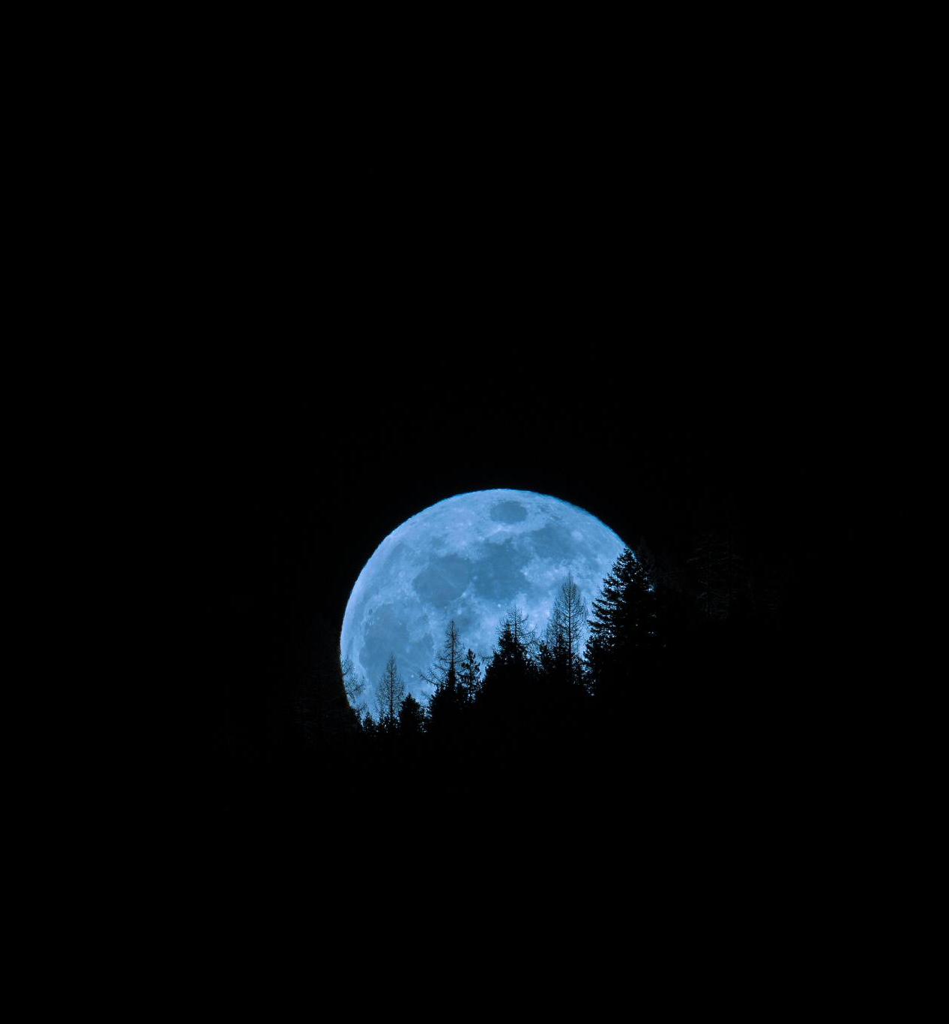
Session Outline
Slide 1: A Majestic Mountain Range
Slide 2: A Vintage Car Show
Slide 3: A Cat in a Funny Costume
Slide 4: A Busy Cityscape at Night
Slide 5: A Delicious Gourmet Meal
Slide 6: A Space Shuttle Launch
Slide 7: A Vintage Record Player
Slide 8: A Scenic Beach Sunset
Slide 9: A Colorful Hot Air Balloon Festival
Slide 10: A Group of Friends Hiking
Notes:
--- In this session, we will dive into ten diverse topics ranging from the beauty of nature to the excitement of space exploration. Each topic is designed to ignite your creativity and provide a platform for spontaneous storytelling. Image source: Microsoft 365 content library

Slide 3
Slide 1: A Majestic Mountain Range
Notes:
Mountains are awe-inspiring natural formations that offer breathtaking views and thrilling adventures. We will explore the importance of nature in our lives and the various hiking trails that beckon outdoor enthusiasts.

Slide 4

Exploring the Beauty of Nature
Stunning Landscapes
Mountains offer breathtaking landscapes that captivate the eyes and rejuvenate the soul.
Fresh Mountain Air
The fresh, crisp air in the mountains provides a refreshing escape from city life and promotes well-being.
Peaceful Escape
The serene environment of mountain ranges offers a peaceful retreat for nature enthusiasts seeking tranquility.
Notes:
--- Nature's grandeur is best experienced in the mountains, where stunning landscapes meet fresh air. The beauty of majestic mountain ranges provides a peaceful escape for all nature lovers. Image source: Microsoft brand library

Slide 5
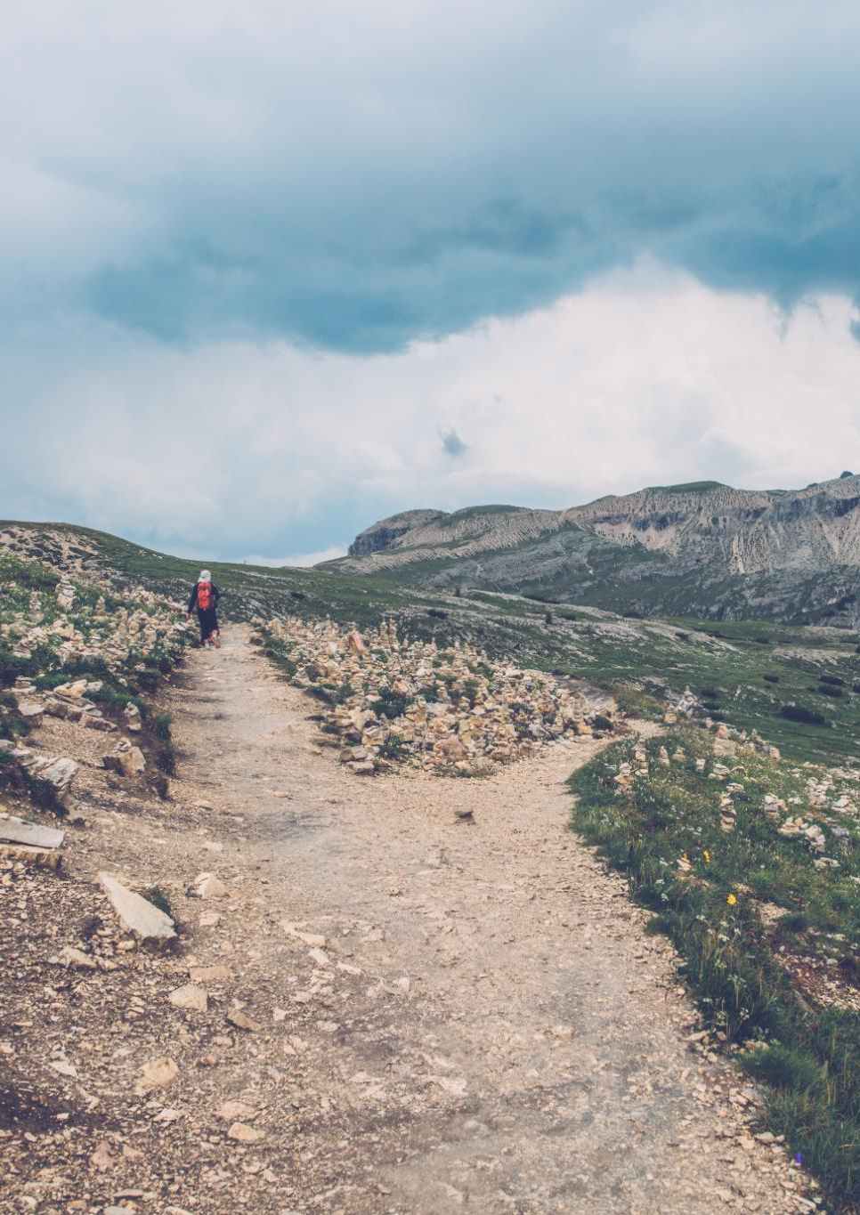
Adventures and Hiking Trails
Beginner Hiking Trails
Beginner hiking trails provide accessible pathways for those new to hiking, offering stunning views and easy navigation.
Challenging Climbs
For seasoned hikers, challenging climbs offer thrilling experiences and breathtaking vistas, testing their skills and endurance.
Diverse Outdoor Experiences
Hiking in mountainous regions provides opportunities to explore diverse ecosystems and encounter wildlife along the way.
Notes:
--- Hiking trails in mountainous regions offer adventurous experiences for all skill levels. From beginner paths to challenging climbs, there's always a new adventure waiting in the great outdoors. Image source: Microsoft 365 content library

Slide 6
Slide 2: A Vintage Car Show
Notes:
Vintage car shows celebrate the beauty of classic automobiles, showcasing the craftsmanship and design from past decades. These events are a haven for car enthusiasts and collectors alike.

Slide 7

Car Enthusiasts and Collectors
Passion for Vintage Cars
Car shows bring together enthusiasts who share a deep love and appreciation for vintage automobiles, showcasing their unique features.
Preservation of Classics
Collectors take pride in preserving classic cars, ensuring they remain in excellent condition for future generations to enjoy.
Community and Connection
Car shows create a sense of community among collectors and enthusiasts, fostering connections through a shared passion for automobiles.
Notes:
--- Car shows gather passionate enthusiasts who share their love for vintage automobiles. Collectors pride themselves on preserving these classic cars for future generations to appreciate. Image source: Microsoft 365 content library

Slide 8
Slide 3: A Cat in a Funny Costume
Notes:
Dressing up pets in costumes is a trend that brings joy and laughter to many households. Our furry friends have become fashion icons thanks to their adorable outfits.

Slide 9

Pet Fashion Trends
Emerging Fashion Styles
Pet fashion is continuously evolving, with new styles that cater to diverse tastes and preferences. Unique designs highlight the individuality of each pet.
Seasonal Costumes
Seasonal costumes have become a favorite for pet owners, allowing pets to join in on holidays and celebrations. These costumes often reflect festive themes.
Themed Outfits
Themed outfits enable pet owners to express their pet's personality or interests, ranging from sports teams to popular characters and more.
Notes:
--- Pet fashion has exploded in popularity, with unique styles and trends emerging. From seasonal costumes to themed outfits, pets are donning apparel that showcases their personality. Image source: Microsoft 365 content library

Slide 10
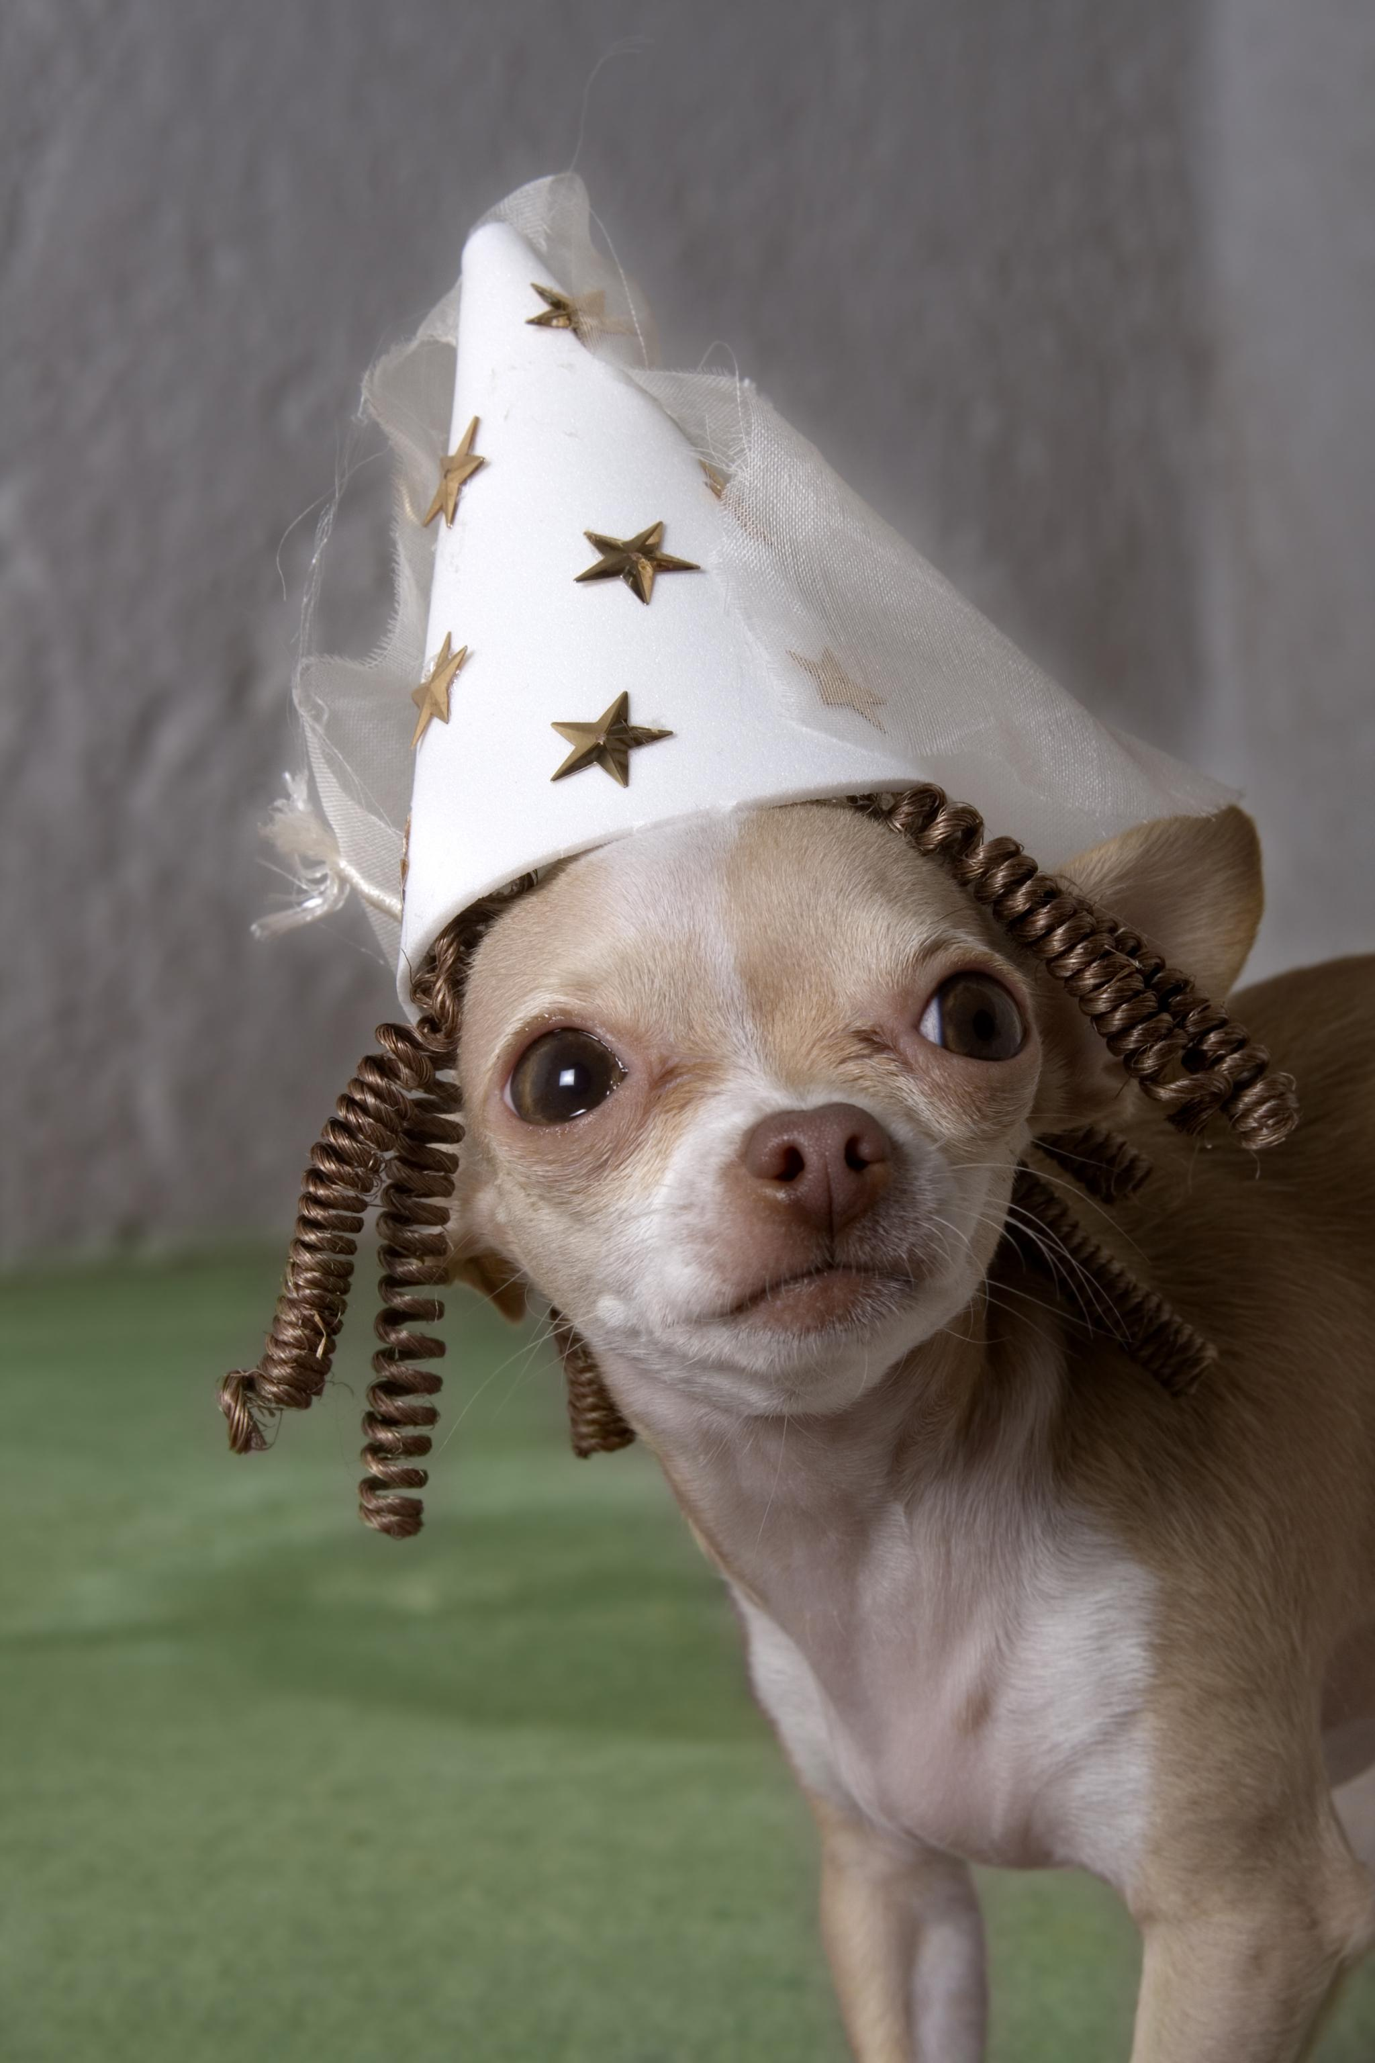
The Joy of Dressing up Pets
Fashion and Fun
Dressing up pets brings a unique sense of fashion and fun for both pets and their owners.
Creating Memorable Moments
Dressing up pets allows for the creation of memorable moments and joyful experiences with furry friends.
Entertainment Value
Watching pets in costumes provides endless entertainment and joy, making everyday moments special.
Notes:
--- Dressing up pets is not just about fashion; it’s about creating memorable moments. Watching a pet in a funny costume can brighten anyone's day and provide endless entertainment. Image source: Microsoft 365 content library

Slide 11
Slide 4: A Busy Cityscape at Night
Notes:
Cityscapes come alive at night, showcasing the vibrancy and energy of urban life. The contrast of lights and shadows creates a captivating view that reflects the bustling lifestyle of city dwellers.

Slide 12

Life in a Metropolitan City
Diverse Cultures
Metropolitan cities are melting pots of diverse cultures, offering residents a rich tapestry of experiences and traditions.
Entertainment Options
Cities provide abundant entertainment options including theaters, museums, restaurants, and nightlife to explore.
Fast-Paced Living
Life in a metropolitan city is often fast-paced, requiring residents to adapt quickly to an ever-changing environment.
Crowded Spaces
The challenge of crowded spaces is common in metropolitan cities, impacting daily commuting and living experiences.
Notes:
--- Living in a metropolitan city provides access to diverse cultures, entertainment, and opportunities. However, it also brings the challenges of fast-paced living and crowded spaces. Image source: Microsoft brand library

Slide 13
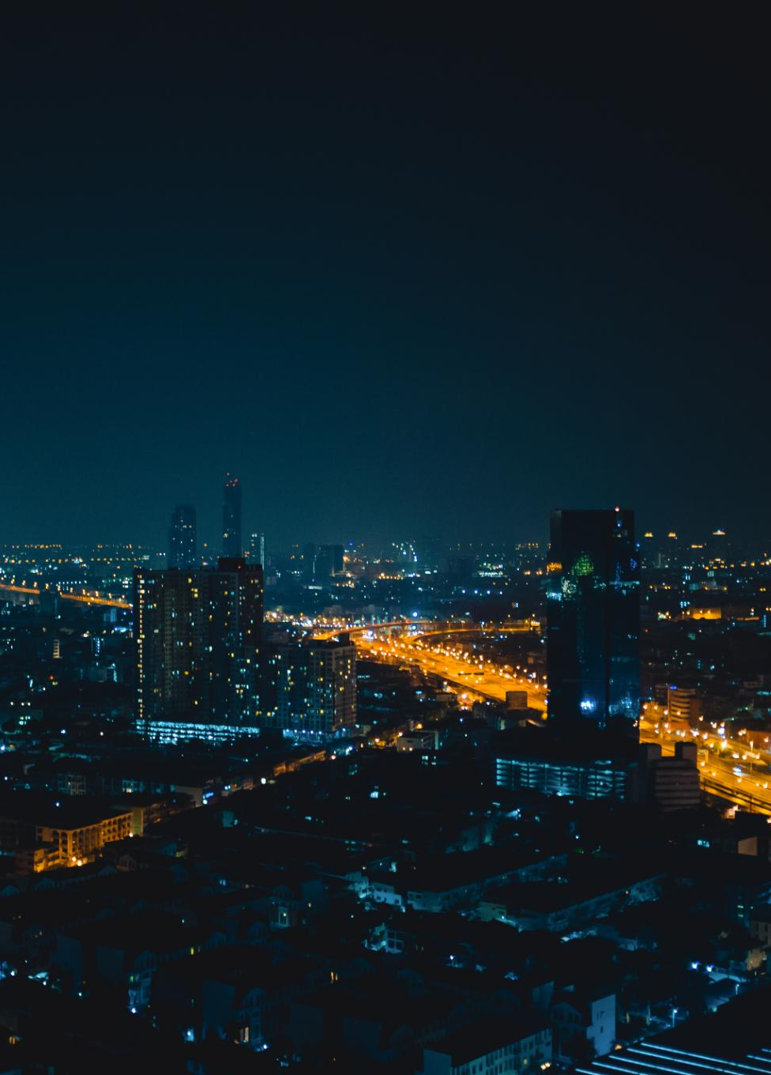
The Vibrancy of Urban Nightlife
Bustling Nightlife
Urban nightlife is characterized by a variety of activities including dining, dancing, and entertainment options that attract night owls.
Energizing Atmosphere
The city's energy transforms after dark, creating a lively atmosphere filled with music, laughter, and excitement.
Diverse Experiences
From late-night events to unique venues, urban nightlife offers countless experiences that cater to a variety of interests.
Notes:
--- Urban nightlife is bustling with activity, from restaurants to clubs and late-night events. The city's energy transforms after dark, offering countless experiences for night owls. Image source: Microsoft 365 content library

Slide 14
Slide 5: A Delicious Gourmet Meal
Notes:
Gourmet meals are a feast for the senses, combining exquisite flavors, presentation, and culinary artistry. Let's explore the world of gourmet cooking and food presentation.

Slide 15
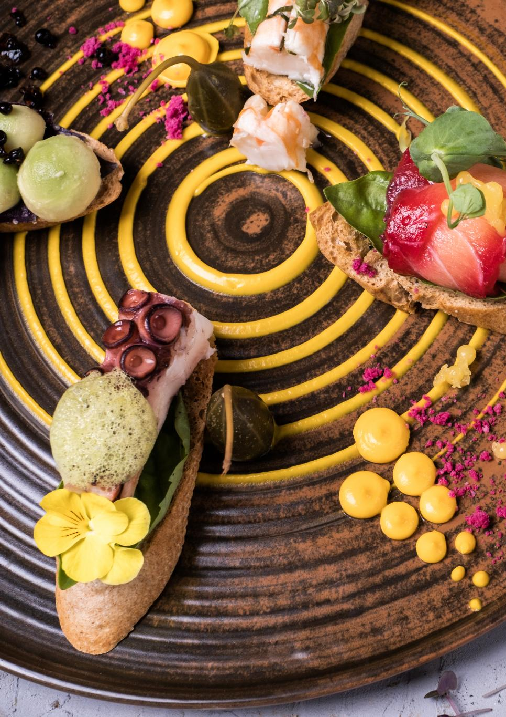
Culinary Arts and Gourmet Cooking
Creativity in Cooking
Culinary arts require creativity, allowing chefs to experiment with flavors and presentation to create exquisite dishes.
Understanding Flavors
A deep understanding of flavors is essential for chefs to combine ingredients and create harmonious dishes that delight diners.
Cooking Techniques
Mastering various cooking techniques is crucial in gourmet cooking, as it impacts the texture and presentation of the meals.
Notes:
--- The culinary arts involve creativity and skill, where chefs create gourmet meals that tantalize the taste buds. Understanding flavors and techniques is essential to gourmet cooking. Image source: Microsoft 365 content library

Slide 16
Food Presentation and Plating
Importance of Presentation
The presentation of food significantly impacts the overall dining experience and enhances the enjoyment of gourmet meals.
Art of Plating
Plating is an art form that transforms a simple dish into a visually appealing masterpiece, elevating the meal's aesthetic quality.
Visual Appeal
A visually stunning dish can enhance appetite and anticipation, making the meal more enjoyable and memorable.
Notes:
--- Presentation plays a crucial role in gourmet meals. The art of plating enhances the dining experience, making a dish not only delicious but visually stunning. Image source: Microsoft 365 content library

Slide 17
Slide 6: A Space Shuttle Launch
Notes:
Space shuttle launches are monumental events that symbolize human ingenuity and exploration. The excitement of a launch captures the imagination of millions around the globe.

Slide 18

Advancements in Space Exploration
Technological Innovations
Recent technological advancements have propelled space exploration efforts, enhancing our capabilities for deep space missions.
Understanding the Universe
Each successful launch helps us gather valuable data, contributing to our understanding of the cosmos and its mysteries.
Future Missions
Future space missions aim to explore new frontiers, including Mars and beyond, as we seek to expand our knowledge and presence in space.
Notes:
--- Advancements in technology have revolutionized space exploration, allowing us to reach new heights and understand our universe better. Each launch brings us closer to unraveling its mysteries. Image source: Microsoft brand library

Slide 19
The Excitement of a Launch
Countdown to Launch
The countdown to a space shuttle launch builds excitement and anticipation, captivating everyone present.
Engine Ignition
The moment the engines ignite is thrilling, as the roar of the engines fills the air.
Soaring into the Sky
Watching the shuttle soar into the sky is an unforgettable experience that showcases human innovation.
Notes:
--- The countdown to a space shuttle launch is exhilarating. Witnessing the powerful engines ignite and the shuttle soar into the sky is an unforgettable spectacle for all. Image source: Microsoft 365 content library

Slide 20
Slide 7: A Vintage Record Player
Notes:
Vintage record players evoke nostalgia and a love for analog music. Despite the rise of digital media, vinyl records have made a significant comeback in recent years.

Slide 21

Nostalgia and Analog Music
Warm Sound Quality
Vintage record players deliver a warm and rich sound that many music enthusiasts find deeply satisfying.
Tactile Experience
Handling vinyl records creates a tactile and engaging experience that enhances the enjoyment of music listening.
Nostalgic Appeal
The use of analog music formats evokes feelings of nostalgia, reminding listeners of the past and cherished memories.
Notes:
--- Listening to music on a vintage record player offers a warm, rich sound that many enthusiasts cherish. The tactile experience of handling records adds to the nostalgia. Image source: Microsoft 365 content library

Slide 22

The Resurgence of Vinyl Records
Growing Popularity
Vinyl records are experiencing a revival, attracting both collectors and new listeners who appreciate the warm sound quality.
Return of Record Stores
The resurgence of vinyl has led to the re-emergence of record stores, creating spaces for music lovers to explore and enjoy.
Joy of Physical Music
Physical formats like vinyl provide a tactile experience that digital music cannot replicate, enhancing the joy of music listening.
Notes:
--- Vinyl records have seen a resurgence in popularity, with collectors and new listeners alike embracing this format. Record stores have reappeared, celebrating the joy of physical music. Image source: Microsoft 365 content library

Slide 23
Slide 8: A Scenic Beach Sunset
Notes:
Beach sunsets are breathtaking displays of nature's beauty. Watching the sun dip below the horizon while waves crash on the shore creates a sense of peace and tranquility.

Slide 24

Relaxation and Beach Vacations
Soothing Ocean Sounds
The calming sound of ocean waves enhances relaxation, making beach vacations a perfect getaway from daily stress.
Warm Sun
The warmth of the sun on your skin contributes to a feeling of comfort and tranquility during beach vacations.
Perfect Atmosphere
Beaches provide an ideal atmosphere for rest and rejuvenation, combining nature's beauty with a peaceful environment.
Notes:
--- Beach vacations are synonymous with relaxation. The soothing sound of the ocean and the warm sun create the perfect atmosphere for rest and rejuvenation. Image source: Microsoft 365 content library

Slide 25

The Beauty of a Sunset
Stunning Visuals
Sunsets are known for their breathtaking beauty that captivates viewers with vibrant colors and serene landscapes.
Interplay of Colors
The unique blend of colors during sunsets creates a magical atmosphere, evoking deep emotions and admiration.
Unique Experience
Each sunset offers a different experience, making it a cherished moment for those who take the time to appreciate it.
Notes:
--- Sunsets create stunning visuals that capture our awe. The interplay of colors paints the sky in vibrant hues, making each sunset a unique experience. Image source: Microsoft 365 content library

Slide 26
Slide 9: A Colorful Hot Air Balloon Festival
Notes:
Hot air balloon festivals are spectacular events that fill the sky with vibrant colors. They offer a sense of adventure and a unique way to experience the beauty of aerial views.

Slide 27
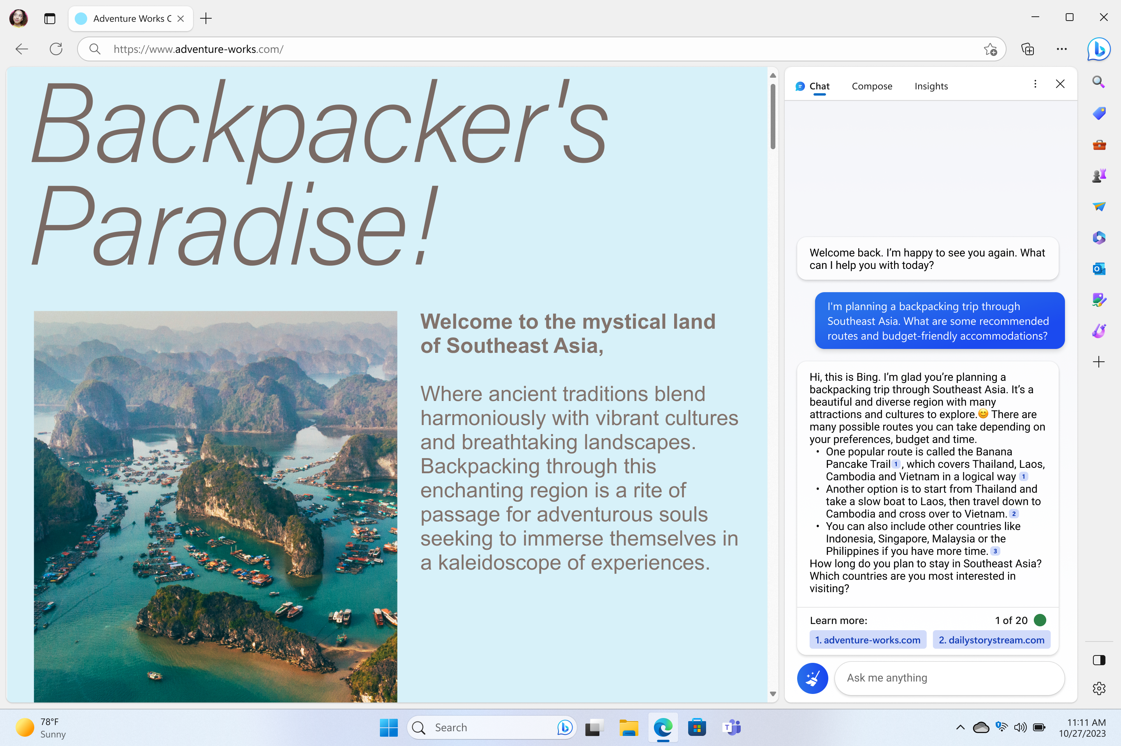
The Thrill of Hot Air Ballooning
Exhilarating Adventure
Hot air ballooning offers a unique adventure that combines the thrill of flight with breathtaking views.
Serene Perspectives
Experience the tranquility of floating high above the ground, enjoying peaceful vistas far below.
Nature's Beauty
Hot air ballooning allows you to immerse yourself in the stunning beauty of nature from a new perspective.
Notes:
--- Hot air ballooning is an exhilarating experience, providing a serene yet thrilling way to view the world from above. It combines adventure with the beauty of nature. Image source: Microsoft brand library

Slide 28
Festivals and Community Events
Community Engagement
Festivals encourage community participation and strengthen local bonds through shared experiences and traditions.
Cultural Traditions
These events celebrate local culture, showcasing traditional foods, music, and performances that enrich community identity.
Entertainment and Activities
Festival activities include entertainment options such as live music, games, and workshops that engage participants of all ages.
Notes:
--- Hot air balloon festivals bring communities together, celebrating local culture and traditions. These events often feature food, entertainment, and opportunities to connect with others. Image source: Microsoft 365 content library

Slide 29
Slide 10: A Group of Friends Hiking
Notes:
Hiking is a fantastic way to bond with friends while enjoying the great outdoors. We’ll explore the benefits of outdoor activities and how they strengthen friendships.

Slide 30

The Benefits of Outdoor Activities
Physical Health Benefits
Outdoor activities like hiking enhance physical health by improving cardiovascular fitness and building strength.
Mental Well-Being
Engaging with nature during outdoor activities reduces stress and promotes mental clarity and happiness.
Connection to Nature
Spending time outdoors fosters a deeper connection to nature, encouraging mindfulness and appreciation for the environment.
Notes:
--- Engaging in outdoor activities like hiking promotes physical health and mental well-being. Nature provides a refreshing escape that rejuvenates the spirit. Image source: Microsoft 365 content library

Slide 31
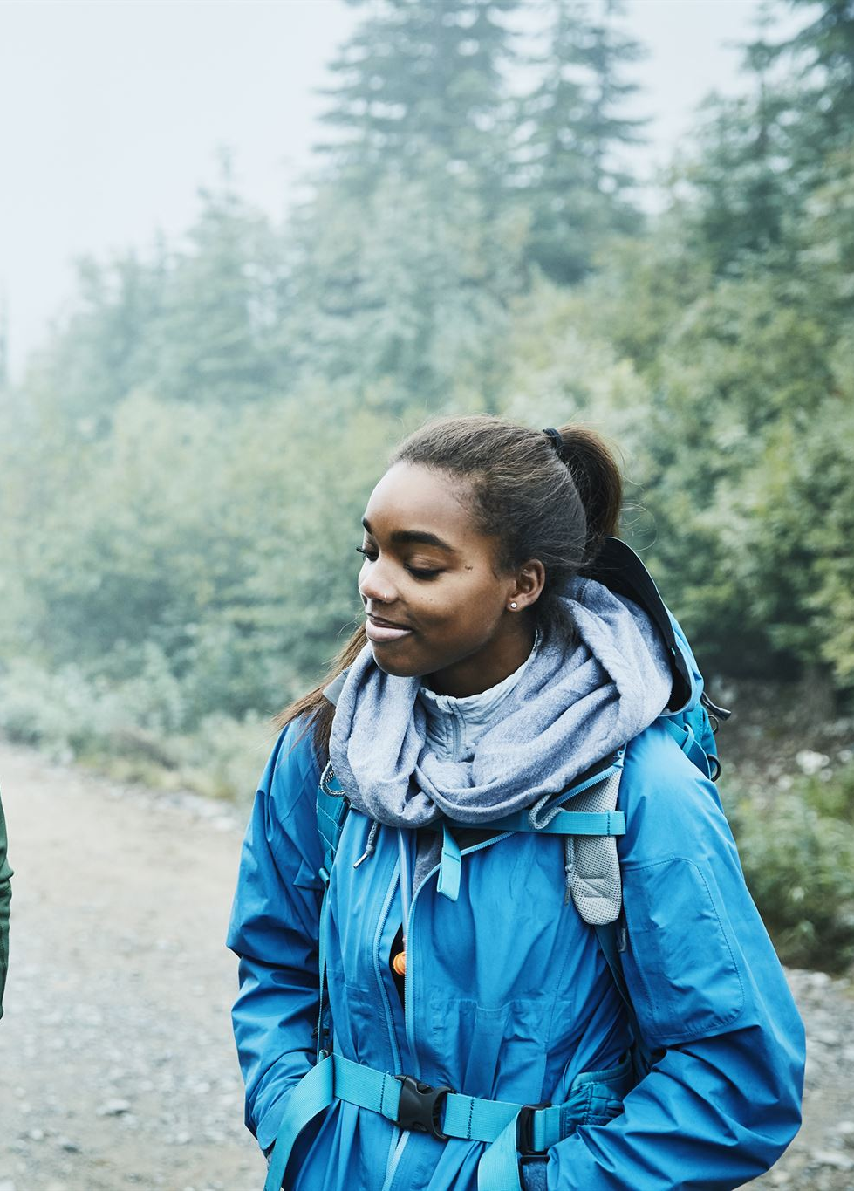
Strengthening Friendships Through Adventures
Creating Lasting Memories
Engaging in adventures together fosters unforgettable experiences, creating lasting memories that friends cherish forever.
Building Stronger Bonds
Shared experiences during activities strengthen friendships, enhancing trust and emotional connections between friends.
Teamwork in Hiking
Hiking together promotes teamwork and communication, essential aspects that enhance relationships through collaboration.
Notes:
--- Shared adventures create lasting memories and strengthen bonds between friends. Hiking together fosters teamwork and communication, enhancing relationships. Image source: Microsoft 365 content library

Slide 32
Conclusion
Celebration of Nature
We embraced the beauty of nature, highlighting its importance in our lives and adventures.
Nostalgia and Memories
Nostalgia plays a significant role in connecting us with our past experiences and cherished moments.
Culinary Delights
Exploring culinary delights allows us to indulge in diverse flavors and cultural experiences.
Adventure and Exploration
Adventure inspires us to explore new places and experiences, creating unforgettable memories.
Notes:
Today, we journeyed through a variety of topics, celebrating nature, nostalgia, culinary delights, and the thrill of adventure. Random PowerPoint Karaoke is a fun way to explore and connect with the world around us.

